Slide 1
USE YOUR STRENGTH !

Slide 2
Project Overview
Name of Project : Use Your Strength ! Project No.: NPAD-2019/10140 Implementation period: 08/2019 - 12/2020 Funding: EUR 30,825.00
Project coordinating institution: Valmieras Gaujas krasta vidusskola – attīstības centrs, Leona Paegles iela 5/7, Valmiera, LV 4201, e-pasts vgv@valmiera.edu.lv, www.vgv.lv
Project partners:
Lithuania: Psichosocialines ir darbo integracijos centras (LT) Center for Psychosocial and Labor Integration Šilo g. 24, LT-04116 Vilnius http://www.pdic.lt Contact person Rūta Mackanienė ruta.elena@gmail.com
Sweden: Folkuniversitetet Kristianstad Folkuniversitetet Föreningsgatan 1, 291 33 Kristianstad, Sweden Växel 044 – 20 76 40 www.folkuniversitetet.se Contact person : Ingmarie Rohdin Ingmarie.rohdin@folkuniversitetet.se
Finland: Engineers Without Borders – Finland Tahtisadeaukio 2 A 12 , 00930, Helsinki, https://www.ewb.fi/ , info@ewb.fi Contact person: Sumita Sahu, sumita@ewb.fi
1

Slide 3
Project Goals
promote effective development of the project's member organizations by raising their professional level, management competencies, teachers and support staff;
to plan and develop the next stage of the project - the development of new, innovative, ICT-based and learnable educational programs for adults.
promote the cooperation of the countries of the Baltic Sea region in the field of education through the cooperation of 4 partner organizations in order to gain international experience and adopt the best practices in planning the content of adult education based on the basic skills of lifelong learning,
The idea of ​​the project – through the cooperation of 4 member states, to acquire knowledge and share good practice
Examples of how to organize adult education more effectively, based on the accepted competences of lifelong learning.
In-depth attention will be paid to the use of ICT tools in education, so that adults from more remote regions and adults
with special needs have equal opportunities to learn the necessary learning content.
2

Slide 4
Project Outcomes
Organizations are able to implement more effective methods for adult education using ICT tools and approaches
Gained improvement working with different groups of adults, such as migrants, people with disabilities,elderly and others communities .
Partners learnt and shared about how to use and adapt the good practices and experiences in their daily works and co-ordinations.
Gained knowledge and informations to motivate adults to engage in non-formal education programs
3

Slide 5
Project Timeline
April 2022
May 2022
Nov 2019
January 2020
May 2022
Finland
Sweden
Latvia
Lithuania
Sweden
Visit to Helsinki
Visit to Kristinstad
Visit to Valmiera
Visit to Vilnus
Visit to Kristinstad
4

Slide 6
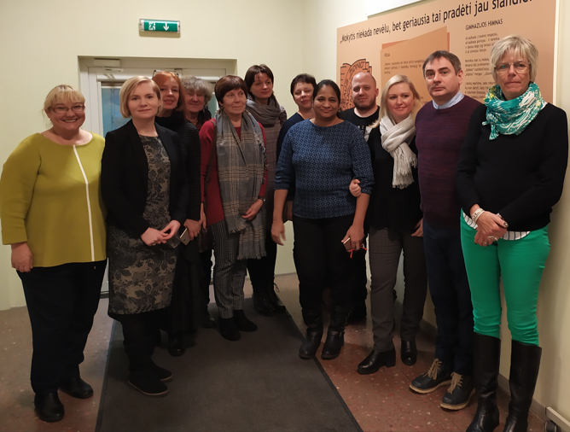
Mobility In Latvia
Interesting programs in Latvia
It is the first international trip for project partners.
The participants visited the University of Applied Sciences
in Vidzeme, the Valmiera Development Agency, the Latvian Employment Agency, and the BUTS training center.
Attended practical trainings about different X, Y and Z
generations and their attitude to work and life values.
Participants visited employement offices and learnt more about skills gap, jobs oppertinites and other challenges.
5

Slide 7
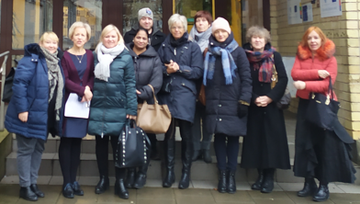
Mobility In Lithuania
Interesting programs in Lithuania
Participants visited and particiated "Zidinio" adult education gymnasium, psychologist and motivational training activities.
Participants got opperttunities to learn different Zirmunai vocational training programs and activities.
They also learnt innovative method in VIGORA simulation
Participants had explored different art therapy techniques
Partcipants had also wonderful city trip to Trakai education and cultural programs .
Participants also got oppertunity to make Kibina Litnuanian national food
6

Slide 8
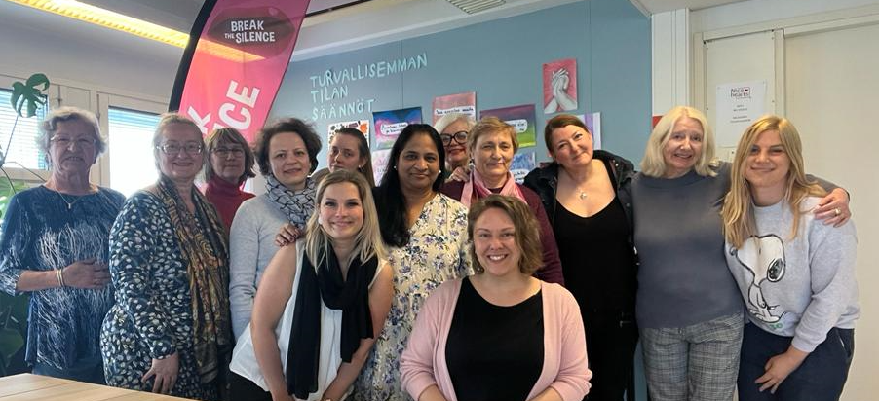
Mobility In Finland
Interesting programs in Finland
Visited the women's aid local organization "Nice Heart "
Visited Finnish university of applied sciences Haaga Helia
Learnt about modern and roboto controlled the central
library of Helsinki "Oodi",
Got oppertunity to visit Education Hub Helsinki and
interacted with Edtech startups
Visited experience center of the international company
and Finnish Brand "Fazer".
Attended a practical training "SDG learning with EWBs"
with “Dome Upcycling”, during which participants created various handicrafts from secondary raw materials
Practiced Jooga in Finnish forest and enjoyed Finnish Sauna
Visited Suomenlinna fort and Finnish national museum
7

Slide 9
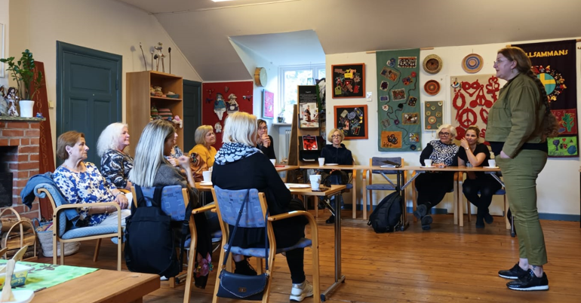
Mobility In Sweden
Interesting programs in Sweden
Participants visited Folk universitetet to understand life long learning programs, adult education system in Sweden as well as different pedagogic method for refuges , adult education and intgration with Swedish job market and life.
Particpants also attended workshop on Naturum Culture program and INAB projects.
Particpants visted SFI prohrams and had interaction with students and teachers.
Participants met local NGO related with adult support and education especially for women.
8

Slide 10
Thank You !
Project Coordinator:
Valmieras Gaujas krasta vidusskola – attīstības centrs, Leona Paegles iela 5/7, Valmiera, LV 4201, e-pasts vgv@valmiera.edu.lv, www.vgv.lv
9

